Slide 1
Session 4
You made it here!

Slide 2
Operational Amplifiers
Integrated circuit that can amplify weak electric signals. 2 input pins and 1 output, basic role is to amplify the voltage difference between the 2 pins.

Slide 3
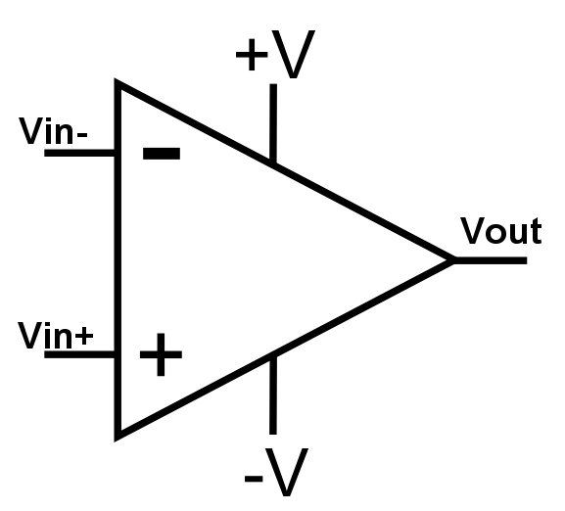


Operational Amplifiers
In an ideal Op Amp, no current is drawn between Vin- and Vin+.
A is the “gain” of the Op Amp.
+V and -V are the power supply voltage.
Op Amps need to be powered.
i=0

Slide 4
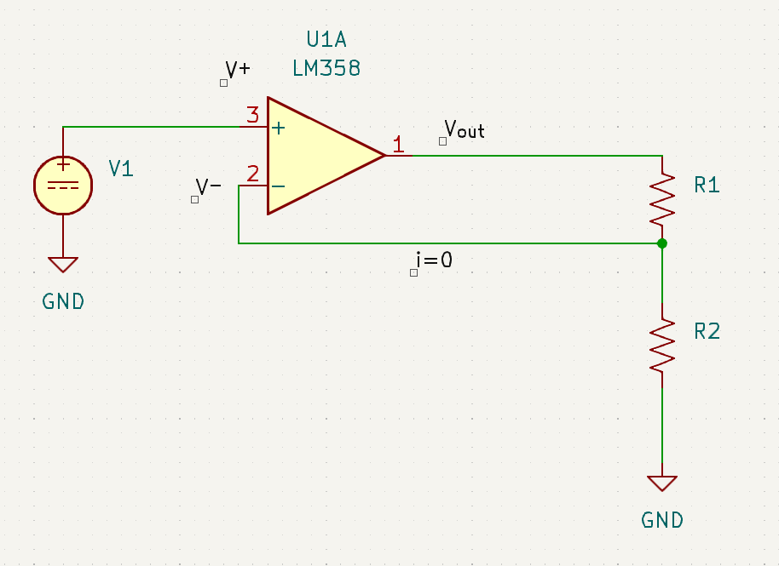
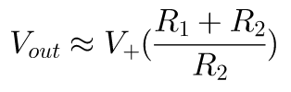
Non-Inverting Op Amp
This provides us a higher voltage than the input based on the resistor values, try measuring them using the multimeter.

Slide 5
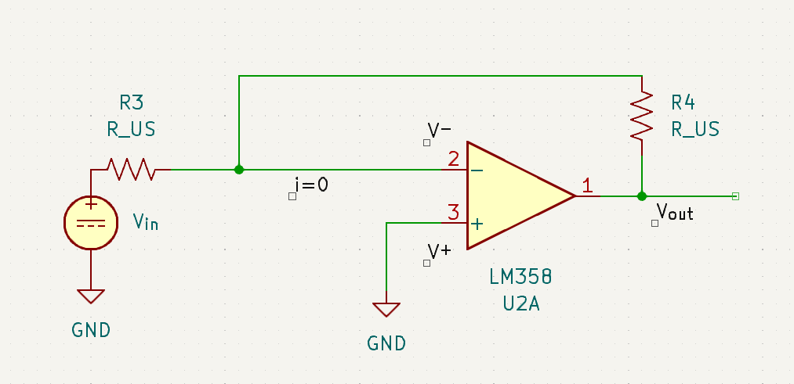
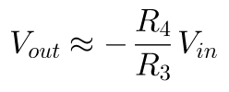
Inverting Op Amp
This connection inverts the output with a voltage factor of R4/R3.

Slide 6
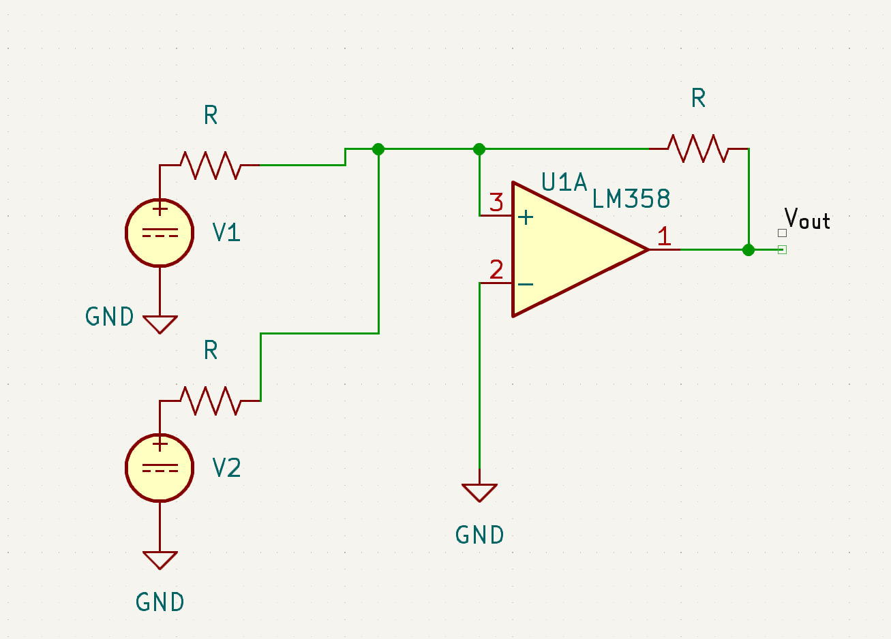

Summing Op Amp
This sums the voltage of V1 and V2 to Vout.
All the Resistors have the same value.

Slide 7
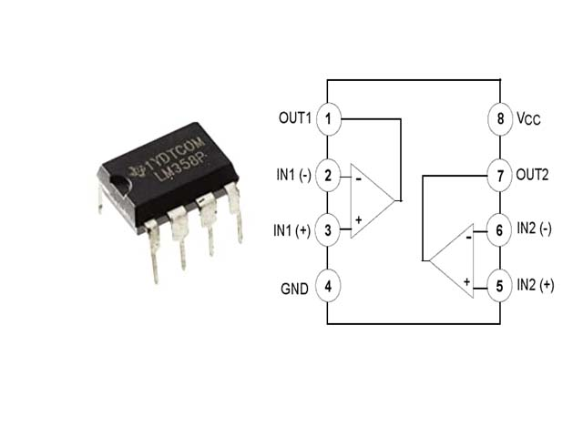
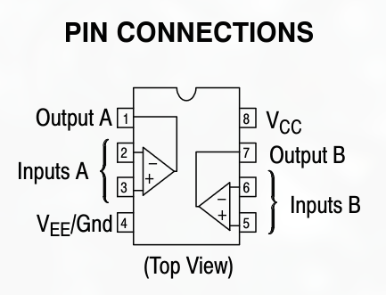
Our Op Amp
LM358
pinout

Slide 8
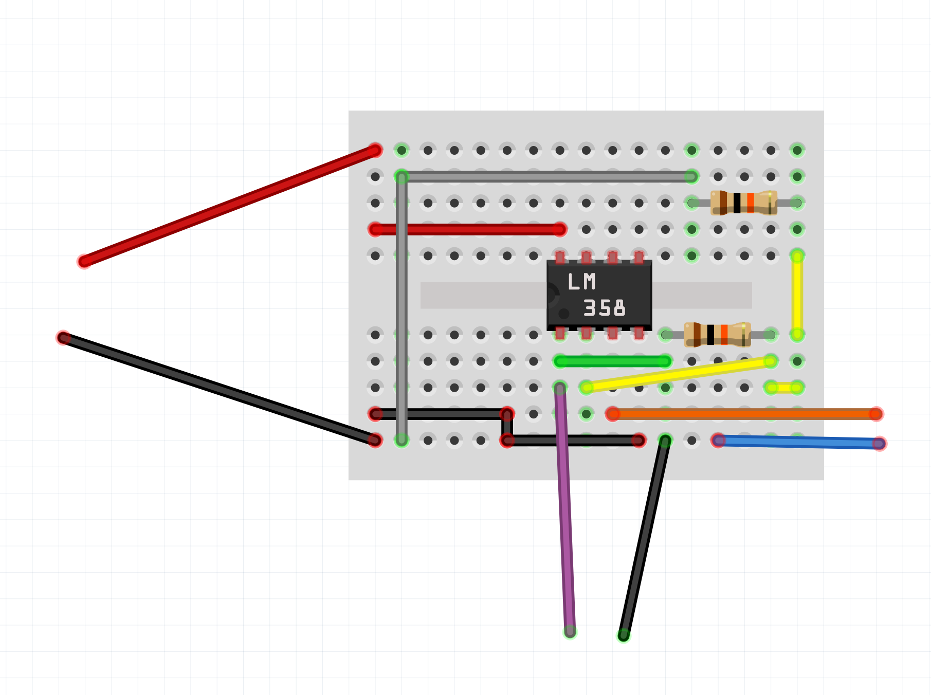
Non-Inverting Op Amp
Power Supply
Voltage
Input
Voltage Output

Slide 9
Challenge
Using the electrical diagram provided, create the inverting Op Amp circuit on a breadboard.
You may request any component/breadboard you need.

Slide 10
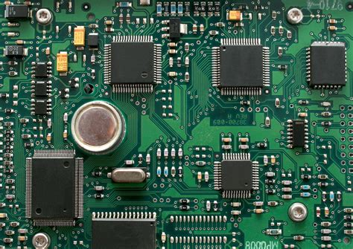
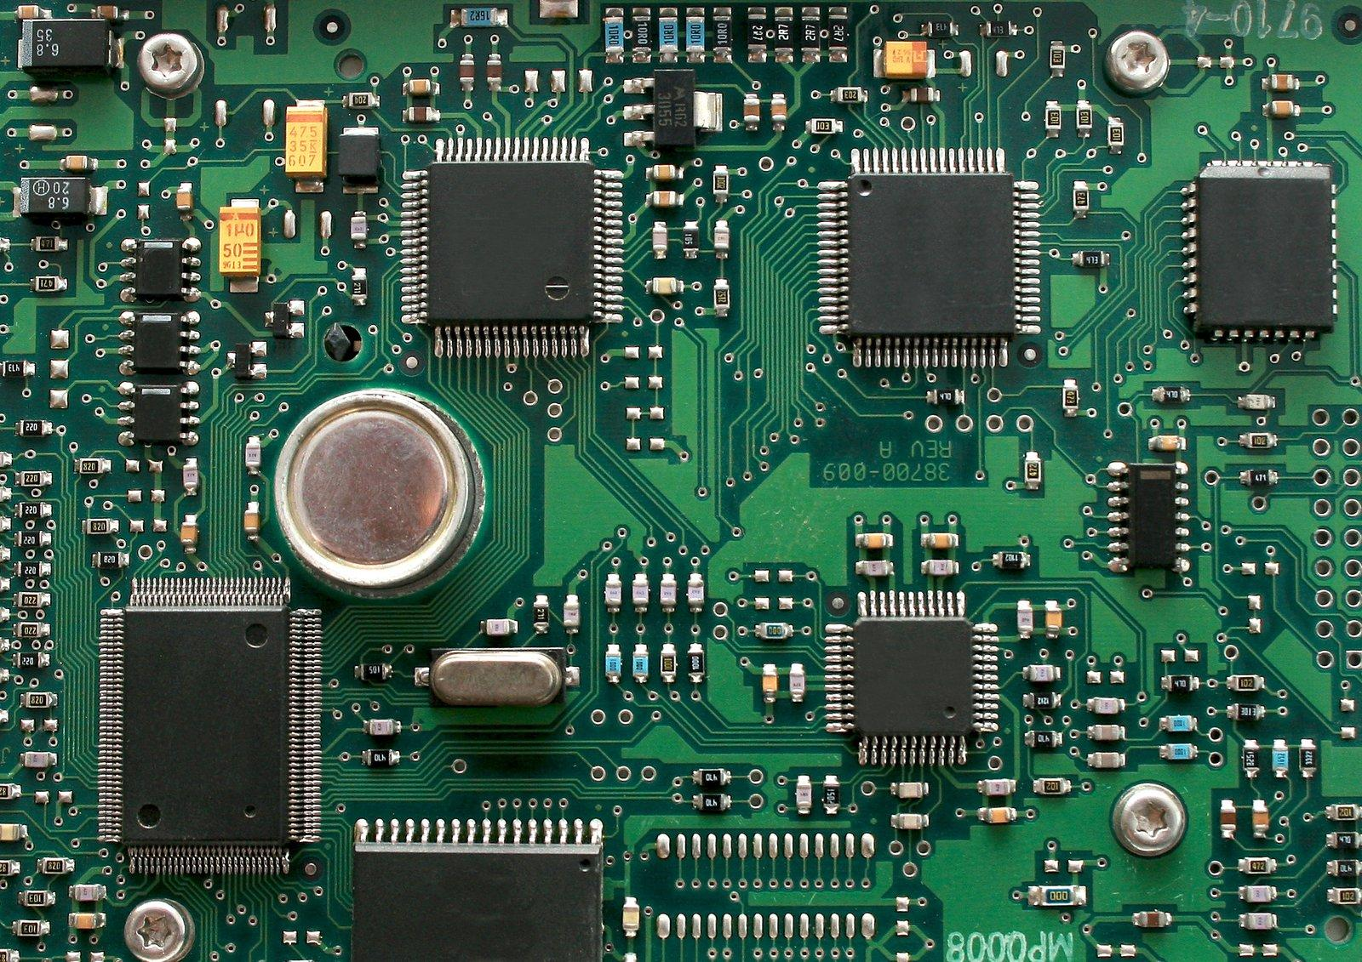
PCB
Printed Circuit Boards help us to organise our circuit, making it error-prone, less wasted wiring material, and more integrated circuits.

Slide 11

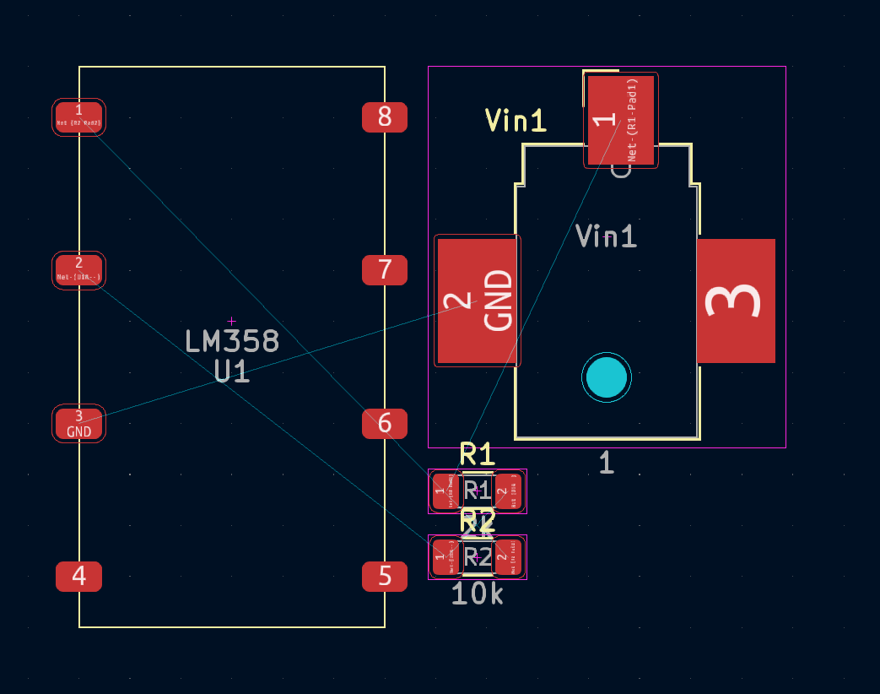
KiCAD: PCB Designing Software
Sample: Inverting Op Amp

